Slide 1
FI520 C++/Python3 projects
Spring 2023

Slide 2
Table of Contents
Development Operations (DevOps)
QLib
C++/Python3 Bindings
Dependencies
Tooling Required
Grading Process

Slide 3
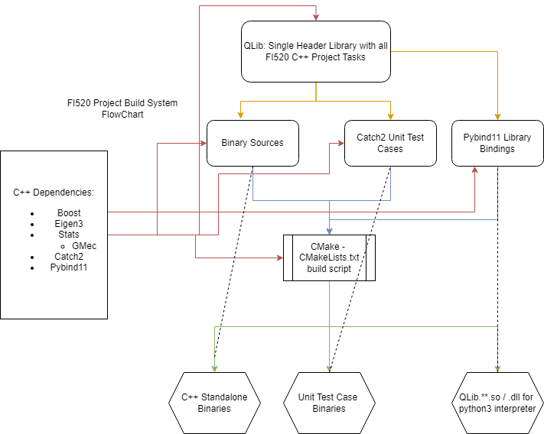
1. DevOps
Goals
Implement functions in C++ and expose them to python3 to practice current modeling tooling and workflows. (Qlib)
Pybind11 is a library that can generate python loadable modules from a c++ codebase via a bindings file.
Catch2 is a unit test library for C++.
CMake is a build system that allows for easy plug-and-play development for C/C++ applications
Git/github source reversioning
Red: Third Party C++ Sources
Blue: Cmake Executables to Build
Yellow: Items that Depend on Qlib
Green: Built Binaries/Libraries/Modules

Slide 4
1.1 DevOps: QLib
Qlib contains all of the assignment required c++ implementations for the projects.
Qlib is validated using unit tests compiled with Catch2 in standalone executables. These are simple and use Catch2::WithCatch2Main.
Qlib is a static header library that can be included into any .cxx source file with #include “qlib.hpp”
The functions in the Qlib namespace are exposed via pybind11 to python3 bindings file src/bindings.cpp
The project with the working out-of-source cmake build system is hosted on github: https://github.com/jsmartini/FI520QuantFin

Slide 5
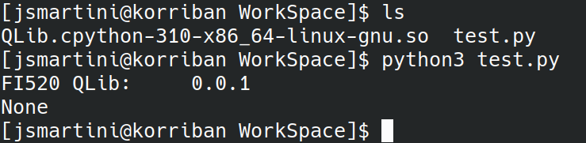
2. Python3/C++ Bindings
Python3/C++ bindings:
Load C++ FI520 Implementations into Python
Process bulk data using Python’s csv and numpy.ndarray apis (swappable with Eigen:Vectorxd<type>)
Data Plotting using Matplotlib (Matlab plotting in python)
Requires only basic python packages and the .so/.dll binary files from the build process to run.

Slide 6
3. C++ Dependencies Used
Eigen3: Linear Algebra Library
Stats: Statistical Library that is compatible with Eigen3
Pybind11: bind c++ code to python3 modules/classes/variables/functions
Gmec: Stats Dependency
Catch2: Unit Test Library
Boost: Enhanced Standard Library (Extension of C++ STL)

Slide 7
4. Tooling
To Build Qlib:
Cmake > 3.9
Clang/GCC/MSVC
Visual Studio (if Windows)
Git
Run git submodule update --init –recursive to download the third-party repositories
Python3 Dependencies to run assignments in python:
Matplotlib
Numpy
Qlib Cpython binary file (either .so or .dll if Windows)

Slide 8
Grading Process
Turn in .zip with the workspace
.zip contains .so or .dll (static binary)
Run assignment.#.py with python interpreter inside of the extracted .zip directory.
All projects are written in python scripts located in ./WorkSpace. Cmake automatically outputs the built Qlib binary python module to this folder by default.

